Slide 1
Chatbot using Deep Learning
Neural Networks

Slide 2
Group member Information
Sai Aditya Guntupalli – 700757316
Mohith Degala – 700746278
Murali Krishna Ponnam – 700755557
Keerthy Pabbathineni - 700747373

Slide 3
Role/Responsibilities and Contribution in project
Name | Role | Responsibility
Mohith Degala | NLP Expert | responsible for data preparation, preprocessing, and feature engineering
Sai Aditya Guntupalli | Model Developer/ | Building and optimising RNN ,BERTmodels using framework PyTorch
Keerthy Pabbathineni | Model integrator | Responsible for model deployment
Murali Krishna Ponnam | Project Coordination and Management | Responsible for coordinating team members

Slide 4
Motivation
The motivation behind the development of FAQ chatbot for University of Central Missouri originated when an internal survey highlighted that a more timely and accurate information system is needed. Due to the recent advancements in deep learning and Natural Language Processing in information retrieval we have developed a chatbot.

Slide 5
Objectives
The main objective of the project is to build the FAQ realtime answering bot for students University related queries using LLM ,GPT API and deep learning models.
The other objectives of the project includes
1.Enabling efficient information retrieval by uploading various data files like PDFs, docs and text documents
2.Providing round the clock answering support
3.Enhancing user experience by introducing the follow up questions
4.Reducing the manual effort like university staff
5.Scalability that is managing large volumes of data

Slide 6
Related work
With the rapid advancement of Conversational AI technologies, the risk of "AI Manipulation Problem" is also growing. This poses a significant danger of targeted influence.Despite its potential impact, overlooked this issue.To address the "AI Manipulation Problem," policymakers should recognize potential risks. The paper suggests the need for regulatory measures [1].
The present chabots are not economical to many organisations and one more drawback is that they are not trained on live data. Most of the organisations need real time updates. In this study we propose real time conversational AI to interact with users and give live updates for the queries. To achieve this NMT and transformer models and RASA framework is used [2].
The main intent of the bots is saving time and reducing manual effort. So far we have bots for different sectors like healthcare, education and banking. But this can be extended to other aspects like reducing the wastage as well. One of the categories is food. In a survey conducted on the reduced wastage food topped the chart. In this paper we are proposing the Recipe bot where the user enters the leftover items or ready perish items in the fridge. Along the leftover item details user enters the calorie and nutrient information also based on this bot suggests the recipes to the users. To build the recipe bot Google Dialog Flow platform to recognize the user’s intentions and Spoonacular API to find recipes are used [3].

Slide 7
Problem Statement
Developing a chatbot using deep learning techniques for efficient information retrieval. The chatbot will interpret natural language queries, retrieve relevant information related to query, and present it to users in a conversational format. Objectives include designing a deep learning model for natural language understanding and evaluating chatbot performance.

Slide 8
Proposed Solution
The project aims to design a chatbot capable of interpreting natural language queries, retrieving rel- evant information, and presenting it in a conversational format. This will be achieved through the utilization of Recurrent Neural Networks (RNNs), specifically imple- mented using frameworks like Keras and TensorFlow. Different types of layers and activation functions will be experimented with to optimize model performance, alongside hyperparameter tuning for enhanced efficiency. Additionally, fine-tuning of Transformer models such as BERT, LLMA 2, and GPT with organizational data is pro- posed to further improve information retrieval

Slide 9
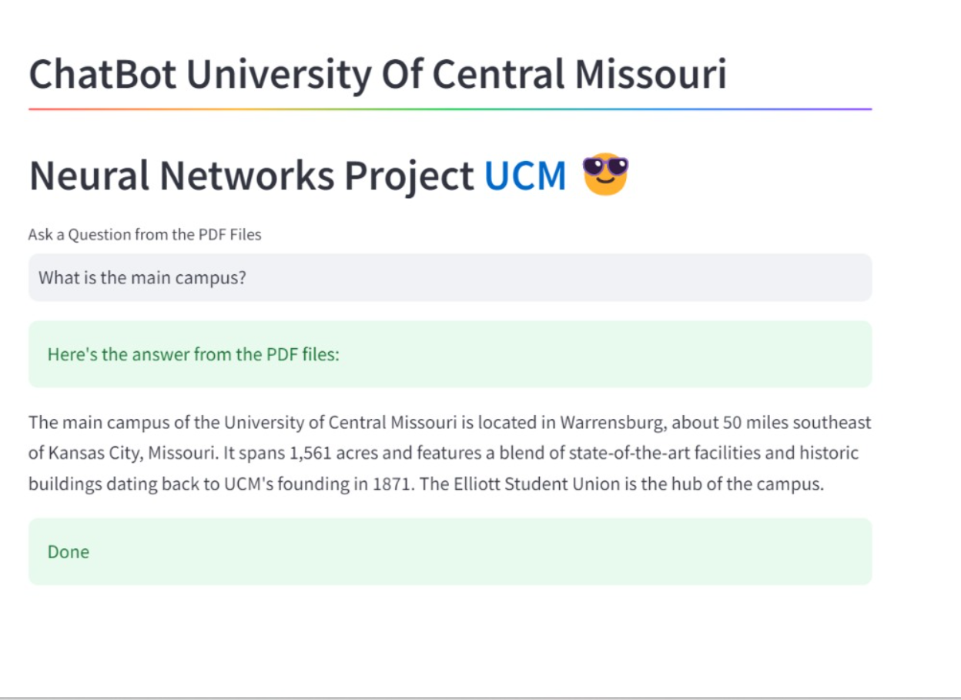
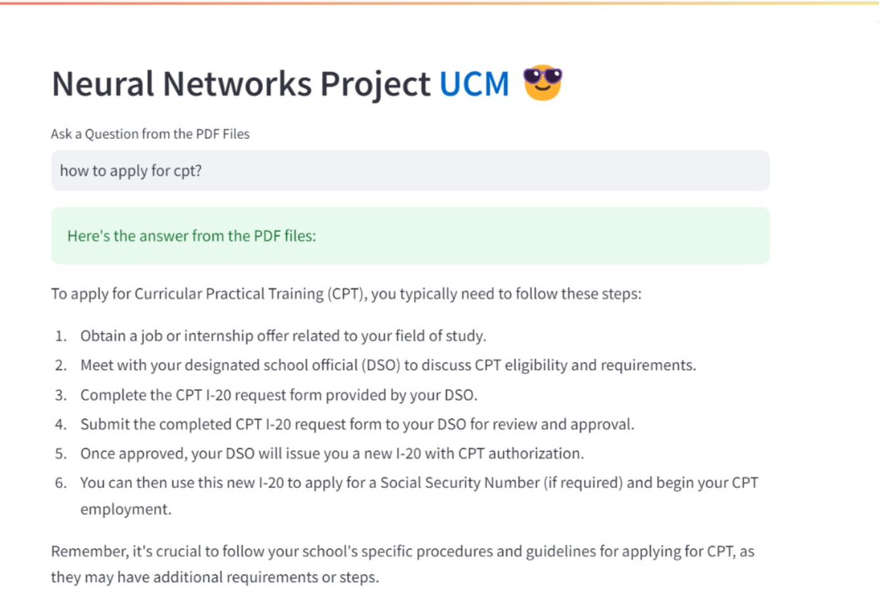
Results/Simulations

Slide 10
References
[1]. Nikhil Kumar Gupta, Anil Chaudhary, Rishabh Singh, and
Rahul Singh. Chatgpt: Exploring the capabilities and limitations
of a large language model for conversational ai. In 2023
International Conference on Advances in Computation, Communication and Information Technology (ICAICCIT), pages
139–142, 2023.
[2].Siddhant Meshram, Namit Naik, Megha VR, Tanmay More, and
Shubhangi Kharche. College enquiry chatbot using rasa framework. In 2021 Asian Conference on Innovation in Technology
(ASIANCON), pages 1–8, 2021.
[3].Gomathyshankar R, Manjit Singh Sodhi, and Kusum Sanal Kumar. Supply chain partner onboarding using conversational ai and nlp in b2b context. In 2022 IEEE International Conference on Electronics, Computing and Communication Technologies (CONECCT), pages 1–4, 2022.

